Slide 1
RCB- IPL Strategy
Rohit Chipate

Slide 2
Problem Statement
You are hired as a sport data analyst by RCB where the team is looking for top-performing and reliable players to win tournaments, considering both on-field performance and value for money in mega player auction of 2017.
Your task is to come up with strategies/suggestions regarding selecting the best-performing players and optimizing player auction investments.

Slide 3
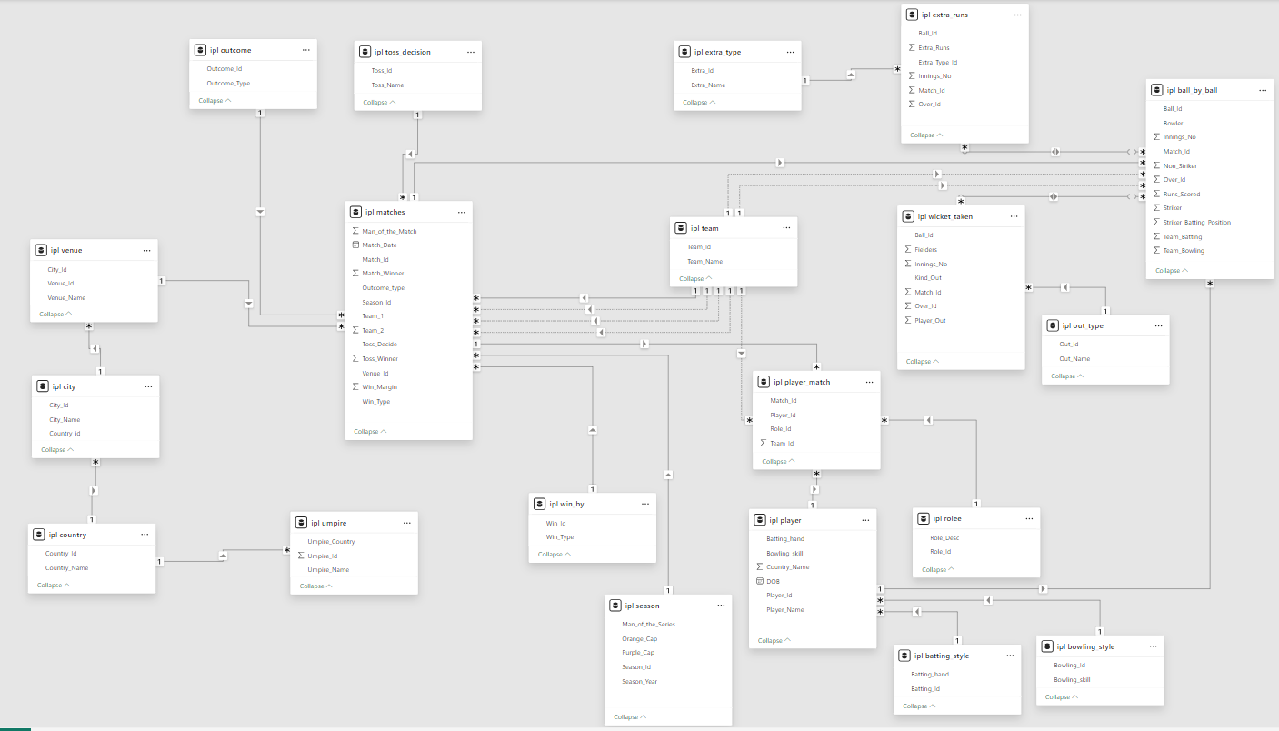
Database Schema

Slide 4
Data Description
Ball by Ball
Match_id: Unique identifier for a cricket match
Over_id: Unique identifier for an over in a cricket match
Ball_id: Unique identifier for a ball in an over
Innings_No: The innings number in a cricket match
Team_Batting: The team batting in a particular innings
Team_Bowling: The team bowling in a particular innings
Striker_Batting_Position: The batting position of the striker batsman
Striker: The batsman currently on strike
Runs_Scored: Total runs scored by Player
Non_Striker: The batsman currently at the non-striker's end
Bowler: The bowler bowling the current delivery
Batting style
Batting_id: Unique identifier for a batsman's batting record
Batting_hand: The batting hand (right or left) of a batsman
Bowling style
Bowling_id: Unique identifier for a bowler's bowling record
Bowling_skill: The bowling skill (e.g., right-arm fast, left-arm spin) of a bowler
City
City_id: Unique identifier for a city
City_Name: The name of a city
Country_id: Unique identifier for a country

Slide 5
Data Description
Umpire
Umpire_id: Unique identifier for an umpire officiating the match.
Umpire_name: The name of an umpire.
Umpire_country: The country or nationality of an umpire.
Player Match
Player_Id: Unique identifier for a player.
Player_Name: The name of a player.
Out_Type
Out_Id: Unique identifier for the type of dismissal or way a batsman got out.
Out_Name: The name or description of the type of dismissal (e.g., caught, bowled, lbw, run out).
Role
Role_Id: Unique identifier for a player's role or skills (e.g., batsman, bowler, all-rounder).
Role_Desc: Description of a player's role or skills.
Team
Team_Id: Unique identifier for a team.
Team_Name: The name of a team.

Slide 6
Data Description
Extra Type
Extra_Id: Unique identifier for an instance of extra runs scored.
Extra_Name: The name or description of the type of extra runs scored (e.g., byes, leg byes, wides, no-balls).
Season
Season_Id: Unique identifier for a particular season or tournament.
Man_of_the_Series: The player awarded the Man of the Series award for a particular tournament.
Orange_cap: The player awarded the Orange Cap (for most runs scored) in a particular tournament.
Purple_cap: The player awarded the Purple Cap (for most wickets taken) in a particular tournament.
Season_Year: Year of the Season
Win_By
Win_Id: Unique Identifier for win type
Win_Type: The type of win (e.g., runs, wickets) achieved by the winning team.
Outcome
Outcome_type: The type of outcome or result of the match (e.g., win, loss, tie, no result).
Outcome_Id: Unique identifier for the outcome or result of a match.
Toss Decision
Toss_Id : : Unique identifier for the toss.
Toss_Name: The name or description of the toss (e.g., heads or tails).

Slide 7
Data Description
Extra Runs
Match_Id: Reference to the match in which the extra runs were conceded.
Over_id: Unique identifier for an over in a cricket match
Ball_Id: Reference to the specific ball during which extra runs were conceded.
Extra_Type_Id: Unique identifier for the type of extra runs scored in a cricket match.
Extra_Runs: The number of extra runs scored in a particular delivery.
Innings_No: The innings number during which the extra run occurred.
Player
Player_Id: Unique identifier for a player.
Player_Name: The name of a player.
DOB: Date of the Birth of a Player
Batting_hand: The batting hand (right or left) of a batsman
Bowling_skill: The bowling skill (e.g., right-arm fast, left-arm spin) of a bowler
Country_Name: The name of a country
Country
Country_id: Unique identifier for a country
Country_Name: The name of a country

Slide 8
Data Description
Matches
Match_Id: Unique identifier for each match.
Team 1:Team 1 in the Match.
Team 2: Team 2 in the Match.
Match_Date: The date when the match took place.
Season_Id: The season in which the match occurred.
Venue_Id: Reference the venue where the match was played.
Toss_Winner: The team that won the toss.
Toss_Decide: Toss decision affecting which team will played batting or bowling.
Win_Type: The method by which the match was won (e.g., runs or wickets).
Win_Margin: The margin by which the match was won.
Outcome_Type: Type of result (win, tie, etc.).
Match_Winner: The team that won the match.
Man_of_the_Match: The player awarded the Man of the Match award.
Wickets Taken
Match_Id: Reference to the match in which the wicket was taken
Over_id: Unique identifier for an over in a cricket match
Ball_Id: Reference to the specific ball during which the wicket was taken.
Player_Out: Reference to the player who was dismissed.
Kind_Out: Reference to the player who was dismissed
Fielder: Reference to the player who fielded the ball.
Innings_No: The innings number in a cricket match.

Slide 9
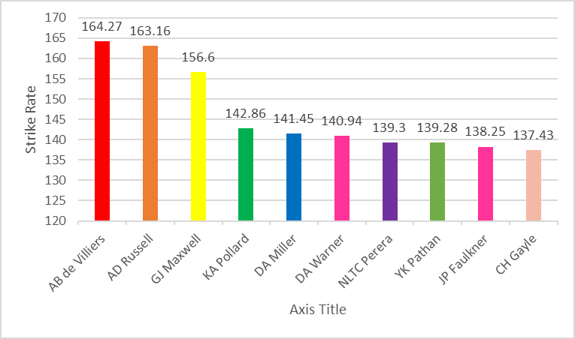
Players With High Strike Rate
Top 10 Performers Ranked by strike rate across the last four seasons to ensure consistency
Strike Rate (Total Runs / Balls Faced) × 100
Strategic Insights Highlights high-impact batters (e.g., AD Russell, AB de Villiers) for team planning

Slide 10
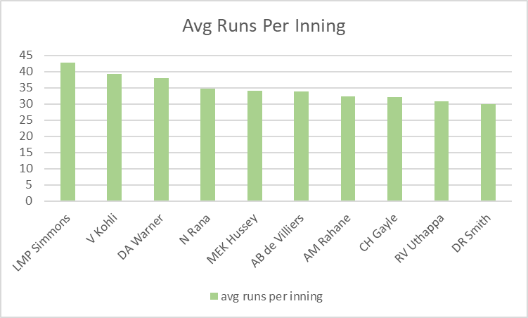
Best Batting Average
Objective Calculate average runs per innings across IPL seasons
Data Sources Player & ball-by-ball tables
Methodology Average = Total Runs / Innings Played
Top Performers Ranked by highest average (e.g., LMP Simmons, V Kohli)

Slide 11
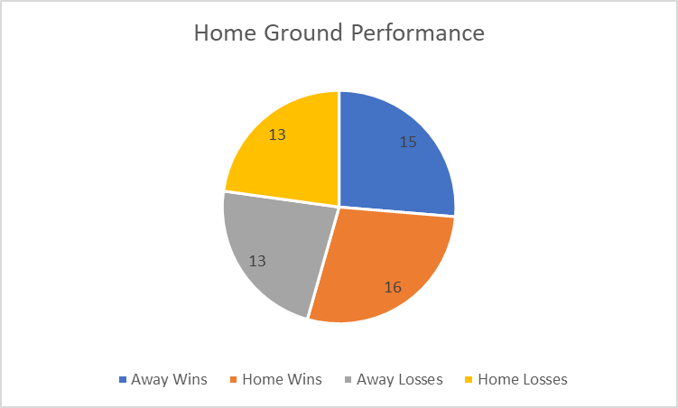
Home Ground Performance
RCB Venue Performance Summary of wins and losses by venue
Data Source Matches, Team & Venue tables
Strategic Insight Evaluates venue-wise consistency for match preparation

Slide 12
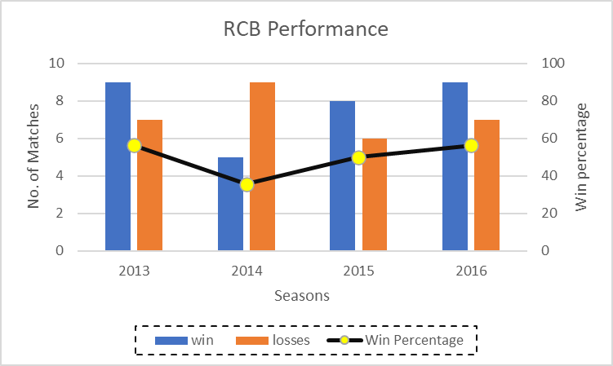
Comparison with Previous Season
Objective Analyze year-on-year IPL team performance
Data Sources Matches, Season, Team, Win_by, Toss_decision
Methodology Compared season-wise wins vs losses
RCB Insights • Win % recovered after 2014 slump • Ended on a strong note in 2016

Slide 13
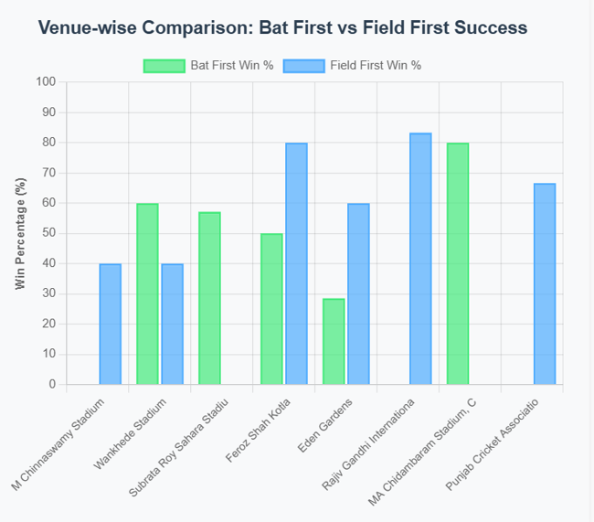
Toss Impact in Different Venues
Venue-Specific Impact
Wankhede (Mumbai): 85.71% wins batting first (strong home advantage)
Chinnaswamy (Bangalore): 62.5% wins fielding first
Feroz Shah Kotla (Delhi): Balanced outcomes for bat & field first

Slide 14
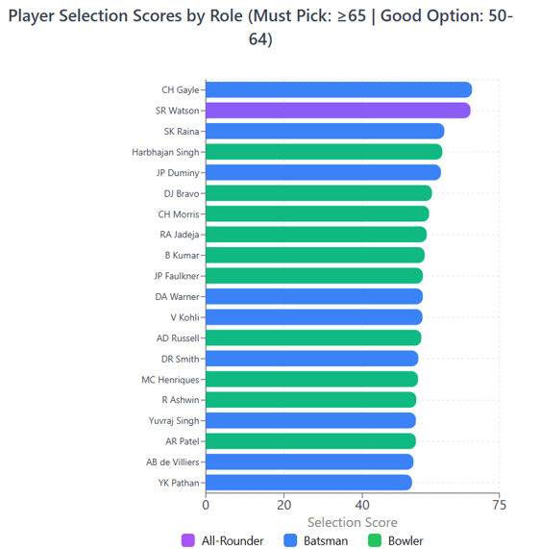
Suitable Players for the Team
CH Gayle: Top performer (68.03) – dominant batsman • SR Watson: Only true all-rounder
• Pure Batsmen: Kohli, Warner, AB – high batting, no wickets • Specialist Bowlers: Bravo (81), B Kumar (77) – strong wicket-takers • Must Picks (≥65): Gayle & Watson

Slide 15
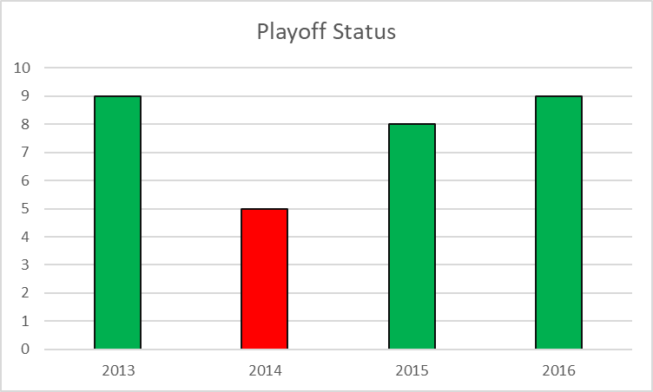
RCB’s Season wise Performance
Playoff Qualification: 75% (3 of 4 seasons) • Total Wins: 31 wins • Average Wins: 7.75 per season • Best Seasons: 2013 & 2016 (9 wins each)

Slide 16
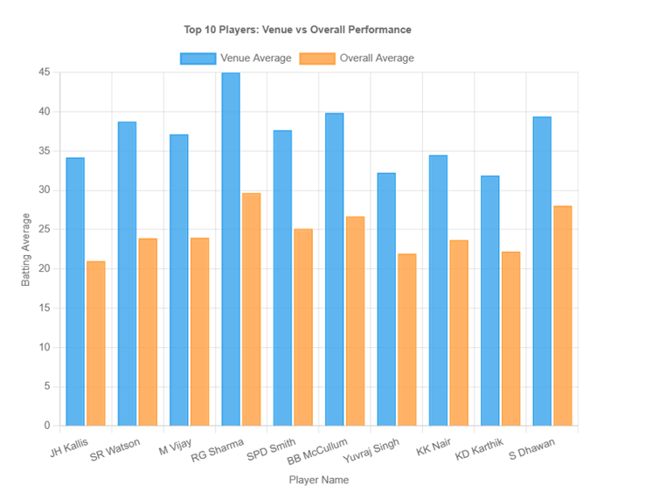
Player’s Performance at Specific Venue
JH Kallis @ Eden Gardens: Most dominant combo • SR Watson @ Jaipur: Strong record at Sawai Mansingh Stadium • M Vijay @ Chandigarh: 54.9% better at PCA Stadium • Venue Trend: Eden Gardens, Kotla & Chepauk favor top batsmen

Slide 17
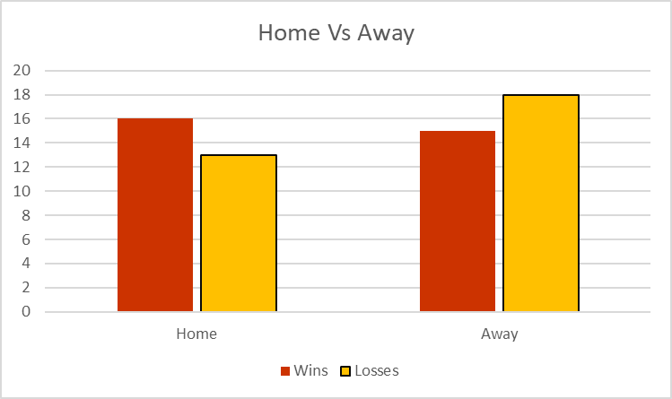
Home vs Away Venue Performance
• Win %: Higher at home (55.17%) vs away (45.45%) • Winning Margin: Stronger at home (72.6 runs) vs away (24.2 runs) • Improvement Area: Strengthen away & neutral venue strategy

Slide 18
Parameters considered during player selection
• Batting: Runs, average, strike rate • Bowling: Wickets, average, economy, strike rate • Team Balance: Experience for strategy + youth for energy

Slide 19
RCB Mega Auction Strategy
• Prioritize powerplay & death-over bowlers • Build a balanced squad (beyond star batters) • Invest in genuine all-rounders • Strengthen middle-order stability • Pick bowlers suited to Chinnaswamy • Reduce reliance on top-order batting

Slide 20
Recommendation
1. Auction & Squad Building:
Target Powerplay & Death Bowlers: Prioritize bowlers with strong records in powerplay and death overs to strengthen bowling at both ends of the innings.
Invest in Genuine All-Rounders: Players like Shane Watson and Dwayne Smith provide balance, reducing dependency on specialist batsmen and bowlers.
Build a Balanced Squad: Move beyond star-heavy batting lineups; focus on middle-order stability and versatile players.
2. Player Selection Criteria:
Venue-Specific Picks: Select players with proven records at Chinnaswamy and other frequent venues (e.g., left-arm fast bowlers, power hitters).
Performance Metrics: Use a weighted scoring system combining batting average, strike rate, bowling economy, and wickets per match.
Youth + Experience: Blend experienced players for strategy with young talent for energy and fielding.
3. Match Strategy:
Toss & Venue Strategy: At Chinnaswamy, consider fielding first (62.5% win rate). At venues like Wankhede, prefer batting first.
Home vs. Away Planning: Develop specific game plans for away matches where RCB’s performance dips significantly.
4. Data-Driven Decisions:
Use historical performance data (last 4 seasons) to identify consistent performers rather than one-season wonders.
Incorporate bowling style analysis (e.g., right-arm medium, left-arm fast) into opposition planning.

Slide 21
Concusion
RCB has shown strong playoff consistency (75% qualification rate) but relies heavily on top-order batting and struggles in away matches.
Team balance is essential – Over-reliance on star batsmen must be reduced by investing in all-rounders and a stable middle order.
Bowling strategy needs refinement – Focus on acquiring powerplay and death-over specialists, especially those suited to Chinnaswamy’s conditions.
Venue-specific planning is crucial – Toss decisions and player selection should be tailored to ground trends (e.g., field first at Chinnaswamy, bat first at Wankhede).
Auction investments must be data-driven – Prioritize players with consistent multi-season performances and clear role clarity.
Youth and experience should be blended – Maintain strategic experience while injecting young talent for energy and fielding strength.
With a structured, analytics-backed approach, RCB can build a more resilient and adaptable squad capable of competing for the IPL title.

Slide 22
Thank You!

